Slide 1
OLO

Slide 3
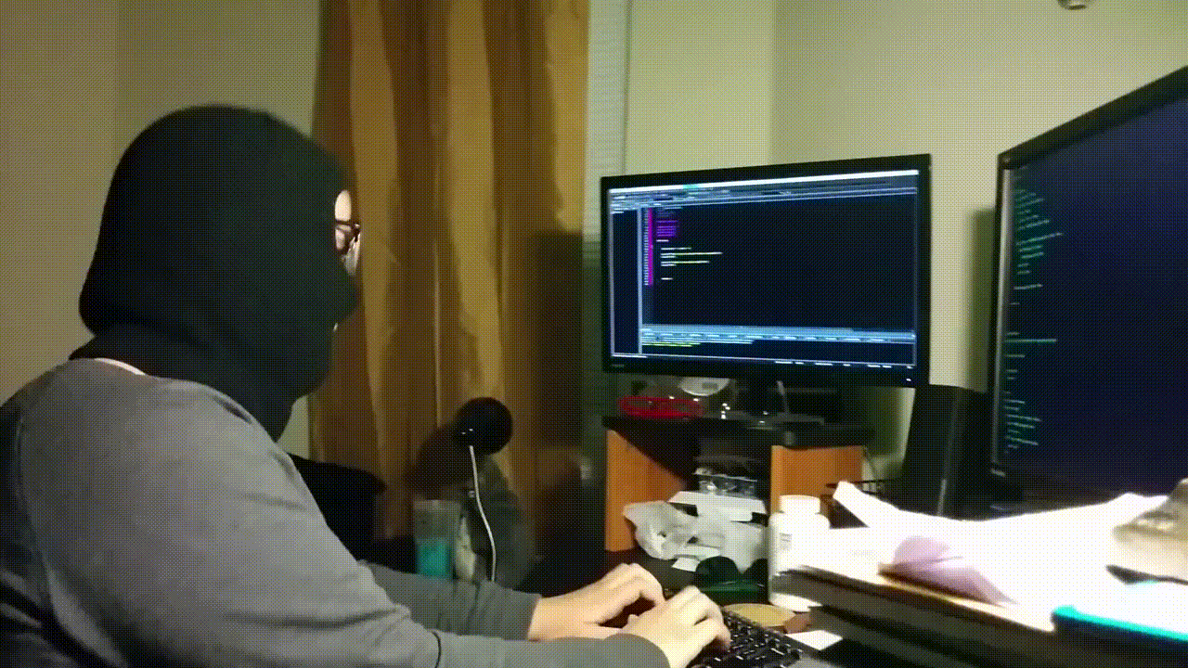

Slide 4
Analysts
Networks
Coders
Teachers
Consultants
Lawyers
Investigators
Writers

Slide 5
Joanna Rubi
@geeitsjo
Bachelor of Science in Computer Science
Victoria University of Wellington Graduate class of 2018
Hailing from Newtown and Jville
Longboarder, surfer, snowboarder
Mum of 5 guinea-pigs
.
.
Security Specialist turned DevOps Engineer at Spark NZ

Slide 6
What’s in a name?
Unravelling the different knights in the Security round table

Slide 7
Sharing some information about the other roles within Security. A name, a job title.
So what’s in a name? That which we call a security role by any other name would sound as sweet.

Slide 8
Mr Robot
Criminal Minds
Snowden

Slide 10
Web Dev > Cyber Security Analyst > Security Specialist > DevOps Engineer
Training Grounds

Slide 11
Security Clearance Security Awareness Governance, Risk, and Compliance team Group Security Cyber Security Analyst Network Engineer Windows and Linux Engineer SIEM Engineer DevOps Engineer
The Village

Slide 12
Focus: Making sure the people we employ are background check. Criminal record investigation Provide information security training Review users with access to restricted areas and information
The Watch
Security Clearance Security Awareness Governance, Risk, and Compliance team Group Security Cyber Security Analyst Network Engineer Windows and Linux Engineer SIEM Engineer DevOps Engineer

Slide 13
Focus: Helping company staff practice good security behaviours Run phishing simulations Internal communications Initiate internal strengthening programme
The Watch
Security Clearance Security Awareness Governance, Risk, and Compliance team Group Security Cyber Security Analyst Network Engineer Windows and Linux Engineer SIEM Engineer DevOps Engineer

Slide 14
Focus: Analysing risk in projects and organising the business to meet standard Security baselines Security Risk Assessments Disaster Recovery and Business Continuity plan Meeting compliance standards
The Watch
Security Clearance Security Awareness Governance, Risk, and Compliance team Group Security Cyber Security Analyst Network Engineer Windows and Linux Engineer SIEM Engineer DevOps Engineer

Slide 15
Focus: Ensuring that good controls are used in the business Incident Responders Red-team pentesters Threat hunting Tuning intrusion detection system(IDS) rules
The Watch
Security Clearance Security Awareness Governance, Risk, and Compliance team Group Security Cyber Security Analyst Network Engineer Windows and Linux Engineer SIEM Engineer DevOps Engineer

Slide 16
Focus: Focusing on responding and managing security incidents DDOS mitigation Tracking user and devices behaviours Phishing and malware analysis Initial IDS alert investigation and mitigation
The Watch
Security Clearance Security Awareness Governance, Risk, and Compliance team Group Security Cyber Security Analyst Network Engineer Windows and Linux Engineer SIEM Engineer DevOps Engineer

Slide 17
Focus: Network infrastructure builders Firewall ADC Proxy Provide network design
The Watch
Security Clearance Security Awareness Governance, Risk, and Compliance team Group Security Cyber Security Analyst Network Engineer Windows and Linux Engineer SIEM Engineer DevOps Engineer

Slide 18
Focus: Focusing on managing important devices Servers alerts Health checks
The Watch
Security Clearance Security Awareness Governance, Risk, and Compliance team Group Security Cyber Security Analyst Network Engineer Windows and Linux Engineer SIEM Engineer DevOps Engineer

Slide 19
Focus: Using Big-Data to better security posture SIEM implementation Big-Data Analytics Predictive analysis
The Watch
Security Clearance Security Awareness Governance, Risk, and Compliance team Group Security Cyber Security Analyst Network Engineer Windows and Linux Engineer Big-Data Engineer DevOps Engineer

Slide 20
Focus: Implementing new tools or tuning current ones Build integrations across multiple platforms Create functionality in the tools Code code code
The Watch
Security Clearance Security Awareness Governance, Risk, and Compliance team Group Security Cyber Security Analyst Network Engineer Windows and Linux Engineer SIEM Engineer DevOps Engineer

Slide 21
University The conferences The interview Job hunting
Dark ages

Slide 22
The importance of passion and network
Dark ages
University
The conferences
The interview
Job hunting
Building a foundation

Slide 23
Theory vs Theory and Knowledge
Dark ages
University
The conferences
The interview
Job hunting
Building a wall

Slide 24
Theory vs Theory and Knowledge
Dark ages
University
The conferences
The interview
Job hunting
Building a wall
Lectures
Assignments
Podcasts
News
Reddit
Meet-ups
Conferences

Slide 25
Theory vs Theory and Knowledge
Dark ages
University
The conferences
The interview
Job hunting
You make time for
what you want to achieve. Nothing falls on
your lap no matter how smart you are.
Building a wall
Lectures
Assignments
Podcasts
News
Reddit
Meet-ups
Conferences

Slide 26
Getting yourself out there in the hunt
Dark ages
University
The conferences
The interview
Job hunting
Building a fort

Slide 27
Getting yourself out there in the hunt
Dark ages
University
The conferences
The interview
Job hunting
Building a fort
Trying even if you don’t meet the job requirements

Slide 28
Getting yourself out there in the hunt
Dark ages
University
The conferences
The interview
Job hunting
Building a fort
Trying even if you don’t meet the job requirements
Learning through the experience, up-skilling as you go

Slide 29
You determine how you sharpen your skills, and your skills will determine how far you go.
Dark ages
University
The conferences
The interview
Job hunting
Soldiering on

Slide 30
You determine how you sharpen your skills, and your skills will determine how far you go.
Dark ages
University
The conferences
The interview
Job hunting
Soldiering on
Your current skills is your foot on the door

Slide 31
Master of keyboard
Know Networking | don’t just learn it
Build code and script | not just one
Analyse and think common sense | don’t over-complicate

Slide 32
So what’s in a name?
Security
It’s not about the hackers, it’s all about our users.

Slide 33
So what’s in a name?
Security
It’s not about the hackers, it’s all about our users.
User needs
User behaviour
User-centric design

Slide 34
LinkedIn
Get your armour on
Security news sources:
SANS ISC – Information, news, podcasts and blogs. Risky.Biz – Australia/NZ security podcast. Paul’s Security Weekly – US security podcast. Threatpost – Industry news. The Register – Industry news.
ZDNet – Industry news.
Subreddits:
/r/Pentesting /r/Homelab /r/Security /r/netsec /r/netsecstudents – They have an AMAZING wiki on how to get started in Security
CV

Slide 35
Fun Exciting Challenging Constantly changing Constantly on the news Big and real implications on lives
Which role will you play in protecting the fort?

Slide 36
Be a good sheep
A wolf in sheep's clothing is an idiom of Biblical origin used to describe those playing a role contrary to their real character with whom contact is dangerous, particularly false teachers. Much later, the idiom has been applied by zoologists to varying kinds of predatory behaviour.

Slide 37
@geeitsjo

